Slide 1
CS 471/571
Ch 1: What Is Software Engineering?

Slide 2
Outline
Why Software Engineering?
Software Development Phases
Maintenance and Economic Aspects
Requirements, Analysis, and Design Aspects
Team Development Aspects
Why No Planning, Testing, or Documentation phase?
The Object-Oriented Paradigm
Ethical Issues

Slide 3
Motivation
1968 NATO Conference, Garmisch, Germany
To solve the software crisis: software is delivered
Late (schedule)
Over budget (cost)
With residual faults (quality)
Popularized by Edsger Dijkstra’s 1972 Turing Award lecture

Slide 4
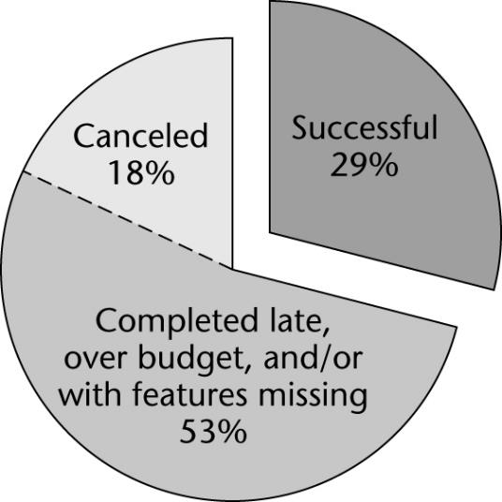
Standish Group Data
Data on 9236 projects completed in 2004
Figure 1.1

Slide 5
Cutter Consortium Data
2002 survey of IT organizations
78% involved in disputes ending in litigation
For the organizations entered into litigation:
In 67% of the disputes, the functionality as delivered did not meet up to the claims of the developers
In 56% of the disputes, the promised delivery date slipped several times
In 45% of the disputes, the defects were so severe that the information system was unusable

Slide 6
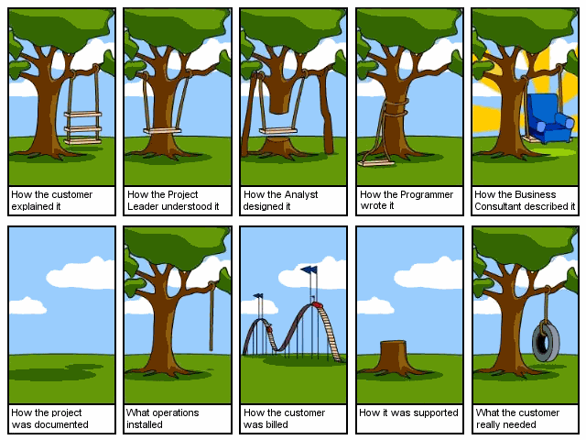
Software Development Nightmare

Slide 7
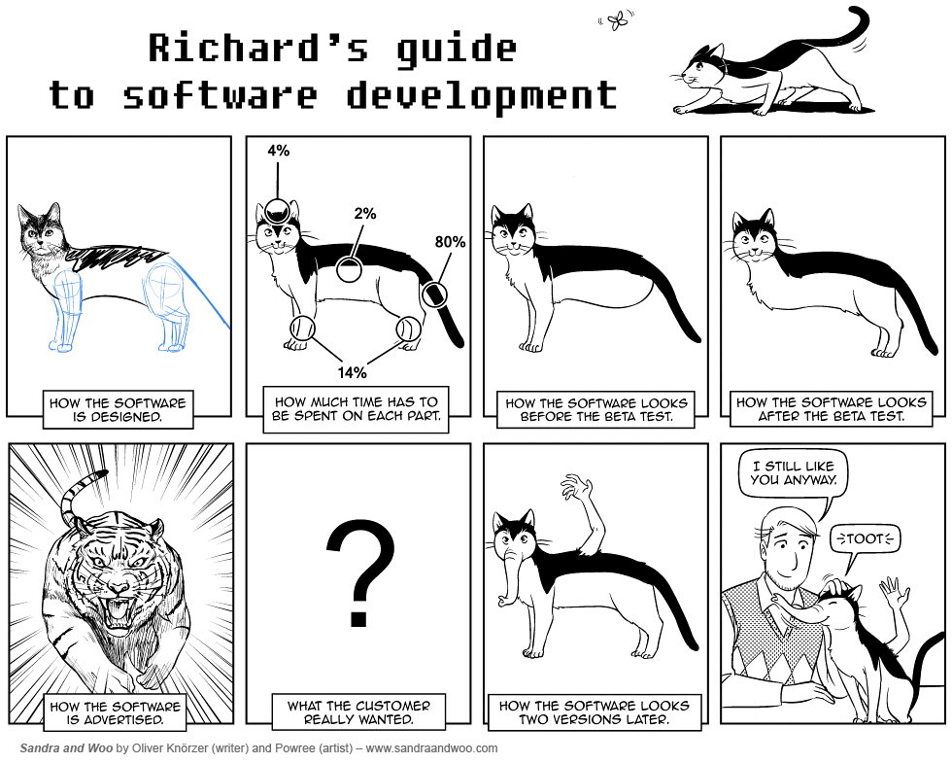

Slide 8
Sample Software Failures
April 2014, “Heartbleed” bug in openSSL
Jan 10, 2013, Java 7 fails to restrict access to privileged code
Nov. 2012, “Google cancels Dec. in Android 4.2”
Mar 2012, the Initial Public Offering of the stock of a new stock exchange cancelled
A U.S. county found that their state's computer software assigned thousands of voters to invalid voting locations in November 2011 for an upcoming election

Slide 9
Sample Software Failures - cont
NASA, 1999
In Oct., the $125M Mars Climate Orbiter spacecraft was believed to be lost in space due to a data conversion error
Software used certain data in English units that should have been in metric units
In Dec., the $165M Mars Polar Lander probe was destroyed in its final descent to the planet
Its software shut the engines off 100 feet above the surface.

Slide 10
Definitions
Software Engineering is a discipline whose aims are:
The production of fault-free software,
Delivered on time and within budget,
That satisfies the client’s needs
The software must be easy to modify when the client’s needs change
Object-Oriented Software Engineering
Utilizes the object-oriented paradigm to achieve the aims of software engineering

Slide 11
Definitions – cont’d
IEEE, 1990
The application of a systematic, disciplined, quantifiable approach to the development, operation, and maintenance of software
The study of the approaches as in 1)
What Is Good Software?

Slide 12
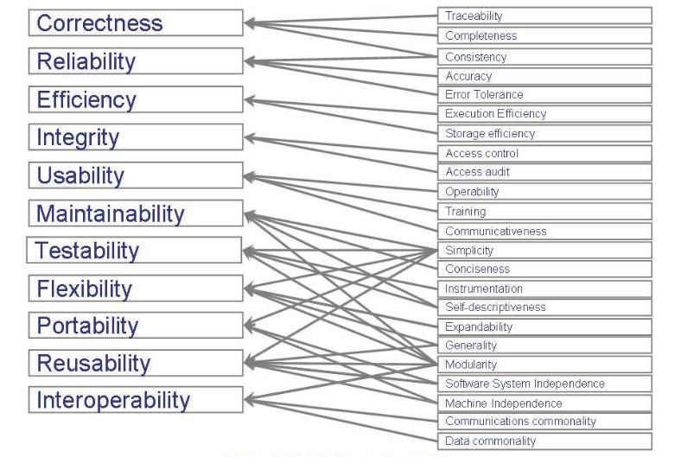
Software Quality: McCall’s Model
External factors
Product quality criteria
Notes:
Shari Lawrence Pfleeger and Joanne M. Atlee, Software Engineering: Theory and Practice, 4th Edition. Prentice-Hall, 2009.

Slide 13
Correctness: Is x := y + 1 Correct?
“Make sure that x and y have different values”
“Make sure that x has a negative value”
Correctness is a relative notion.
Need not only the program but also a precise specification of what it is supposed to do.
Correctness formula: {P}A{Q} , a.k.a. Hoare Triples
“Any execution of A, starting in a state where P holds, will terminate in a state where Q holds.”
{x >= 9} x := x + 5 {x >= 13}
Notes:
Bertrand Meyer. Object-Oriented Software Construction, 2nd Edition, Prentice-Hall PTR, 1997.

Slide 14
Correctness: Whose Fault?
Programmer A
double x = -1;
double y = sqrt(x);
assert abs(y*y-x)<eps
// failure
Programmer B
double sqrt(double x)
{
//…
}
Design by Contract (Meyer, 1997)
Rights and Obligations
“If you promise to call me with the precondition satisfied then I, in return, promise to deliver a final state in which the postcondition is satisfied.”

Slide 15
Reliability
Informally, software is reliable if the user can depend on it
Formally, reliability is the probability that the software will operate as expected over a specified time interval
Statistic behavior, e.g., mean time to failure
Can incorrect software be reliable?
Is the count of faults a good measure of product quality?
Notes:
Ghezzi et al., Fundamentals of Software Engineering, 2e, Prentice Hall, 2003.
Incorrect software may still be reliable if the consequence of a software error is not serious.
Neither a count of faults nor a count of failures gives an indication of the severity of the problems

Slide 16
Development Phases
Software life-cycle model
The steps (phases) to follow when building software
A theoretical description of what should be done
Classical Waterfall Model (1970)
Requirements, analysis (specification),
Design, implementation,
postdelivery maintenance, retirement

Slide 17
Typical Classical Phases
Requirements phase
Explore the concept
Elicit the client’s requirements
Analysis (specification) phase
Analyze the client’s requirements
Draw up the specification document
Draw up the project management plan
“What the product is supposed to do”

Slide 18
Typical Classical Phases (contd)
Design phase
Architectural design, followed by
Detailed design
“How the product does it”
Implementation phase
Coding
Unit testing
Integration
Acceptance testing

Slide 19
Typical Classical Phases (contd)
Postdelivery maintenance
Corrective maintenance
Perfective maintenance
Adaptive maintenance
Preventive maintenance
Retire

Slide 20
Maintenance Aspects
Importance of Postdelivery maintenance
Bad software is discarded
Good software is maintained, for many years
Software is a model of reality, which is constantly changing

Slide 21
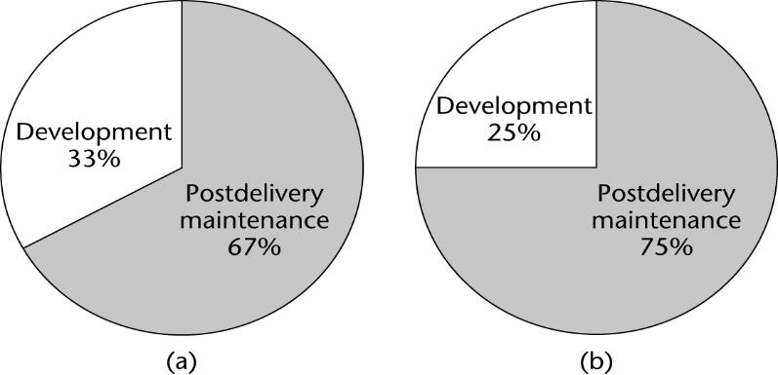
Time (= Cost) of Postdelivery Maintenance
Figure 1.3
(a) Between 1976 and 1981
(b) Between 1992 and 1998

Slide 22
Classical Maintenance View
Development-then-maintenance model
This is a temporal definition
Classification as development or maintenance depends on when an activity is performed

Slide 23
Maintenance vs Development -1
A fault is detected and corrected one day after the software product was installed
Classical maintenance
The identical fault is detected and corrected one day before installation
Classical development

Slide 24
Maintenance vs Development -2
The client wants its functionality to be increased after a software product has been installed
Classical (perfective) maintenance
The client wants the identical change to be made just before installation (“moving target problem”)
Classical development

Slide 25
Maintenance vs Development -3
Development (building software from scratch) is rare today
Reuse is widespread

Slide 26
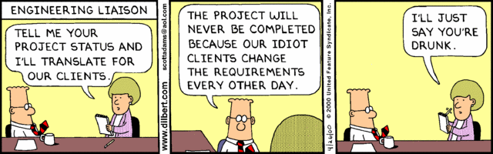

Slide 27
Modern Maintenance Definition
In 1995, the International Standards Organization and International Electrotechnical Commission defined maintenance operationally
Maintenance is nowadays defined as
The process that occurs when a software artifact is modified because of a problem or because of a need for improvement or adaptation

Slide 28
Modern Maintenance Definition (contd)
In terms of the ISO/IEC definition
Maintenance occurs whenever software is modified
Regardless of whether this takes place before or after installation of the software product
The ISO/IEC definition has also been adopted by IEEE and EIA

Slide 29
Maintenance Terminology in This Book
Postdelivery maintenance
Changes after delivery and installation [IEEE 1990]
Modern maintenance (or just maintenance)
Corrective, perfective, or adaptive maintenance performed at any time [ISO/IEC 1995, IEEE/EIA 1998]

Slide 30
Economic Aspects
Coding method CM_{new} is 10% faster than currently used method CM_{old}. Should it be used?
Common sense answer: Of course!
Software Engineering answer
Consider the cost of training
Consider the impact of introducing a new technology
Consider the effect of CM_{new} on maintenance

Slide 31
Requirements, Analysis, and Design Aspects
The earlier we detect and correct a fault, the less it costs us
To correct a fault early in the life cycle
Usually just a document needs to be changed
To correct a fault late in the life cycle
Change the code and the documentation
Test the change itself
Perform regression testing
Reinstall the product on client’s computer(s)

Slide 32
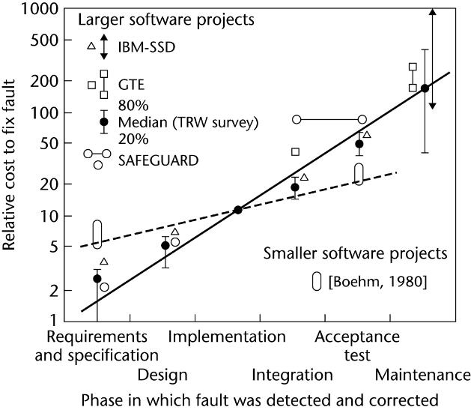
Costs of Fault Detection and Correction

Slide 33
Fault Detection and Correction - cont
Between 60 and 70% of all faults in large-scale products are requirements, analysis, and design faults
Example: Jet Propulsion Laboratory inspections
1.9 faults per page of specifications
0.9 per page of design
0.3 per page of code

Slide 34
Team Programming Aspects
Software is built by teams
How many LOC/day can John and Dave produce if they work together?
Suppose individual productivity is 100 LOC/day
Communication problems among team members

Slide 35
Team Aspects – cont’d
Why does software have defects even though the programmers are very skilled?
“competent programmer hypothesis”
Interfacing problems between modules
In good software developed under a good process, most of bugs found during behavioral testing are due to :
Unpredictable interactions between modules, or
Unpredictable side effects of seemly innocent modules

Slide 36
Why There Is No Planning Phase
We cannot plan at the beginning of the project —we do not yet know exactly what is to be built
Typically, planning activities are carried out throughout the life cycle

Slide 37
Planning in the Waterfall Model
Preliminary planning of the requirements and analysis phases at the start of the project
The software project management plan is drawn up when the specifications have been signed off by the client
Management needs to monitor the SPMP throughout the rest of the project

Slide 38
Why There Is No Testing Phase
It is far too late to test after development and before delivery
Continual testing activities must be carried out throughout the life cycle

Slide 39
Testing in the Waterfall Model
Verification
Build the system right?
Testing at the end of each phase (too late)
Validation
Building the right system?
Testing at the end of the project (far too late)

Slide 40
Why No Documentation Phase
It is far too late to document after development and before delivery
Documentation activities must be performed in parallel with all other development and maintenance activities

Slide 41
Documentation Must Be Current
Key individuals may leave before the documentation is complete
We cannot perform a phase without having the documentation of the previous phase
We cannot test without documentation
We cannot maintain without documentation

Slide 42
Comments on Comments
Comments: seemingly minor details, great impact on the code quality!
“NO COMMENT” - comments may hide the bad smell of code
Code is poorly written,
Names are badly chosen,
Never write unnecessary comments

Slide 43
The Object-Oriented Paradigm
The structured paradigm was successful initially
Started to fail with larger products (50+KLOC)
Postdelivery maintenance problems
Today, 70 to 80% of total effort
Reason: Classical methods are
Action oriented; or
Data oriented;
But not both

Slide 44
The OOP (contd)
Both data and actions are of equal importance
Object:
A component that incorporates both data and the actions that are performed on that data
Example: Bank account
Data: balance
Actions: deposit, withdraw, determine balance

Slide 45
Characteristics of OOP?
Encapsulation
Object/class
Inheritance
Polymorphism & Dynamic Binding
…

Slide 46
Theoretical Foundation of OOP?
Abstract Data Types
A class is an ADT equipped with a possibly partial implementation.
Inheritance vs Subtyping?

Slide 47
Strengths of OOP
With information hiding, postdelivery maintenance is safer
The chances of a regression fault are reduced
Development is easier
Objects generally have physical counterparts
This simplifies modeling

Slide 48
Strengths of OOP - contd
Well-designed objects are independent units
Everything that relates to the real-world item being modeled is in the corresponding object — encapsulation
Communication is by sending messages
This independence is enhanced by responsibility-driven design

Slide 49
Weaknesses of the OOP
When used correctly, it can solve some, but not all, of the problems
It has problems of its own
Scripting - Jython
Functional programming - Scala on Java VM
Crosscutting concerns - AspectJ
It is the best alternative available today
However, it is certain to be superceded by something better in the future

Slide 50
Ethical Issues
Developers and maintainers need to be
Hard working, intelligent, sensible
Up to date and, above all, ethical
Malicious code? white-collar crime, backdoor, malware
Hacking?
IEEE-CS ACM Software Engineering Code of Ethics and Professional Practice www.acm.org/serving/se/code.htm

